Slide 1
Business Proposal
is Manhattan the best place to open a new Pizza Restaurant?

Slide 2
Requirements
From business owner’s point of view, he wants to have less competitors but more bars around the neighborhood. Pick a location for his business is the priority.
Get the neighborhood data
Analyze the neighborhood based on the data provided

Slide 3
Data Cleaning
Get the location data to analyze neighbors New York Neighborhood
Normalize the data
Remove data which has less impacts on the decision making

Slide 4
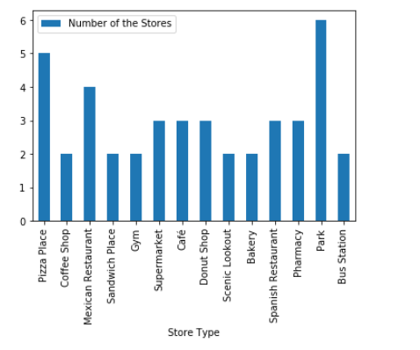
Manhattan Area
Manhattan area has 5 pizza shops within 1000 meters. It has several Mexican and Spanish restaurant.
Advantage: it has many parks around, could be a popular place for picnic.
Disadvantage: Many competitors

Slide 5
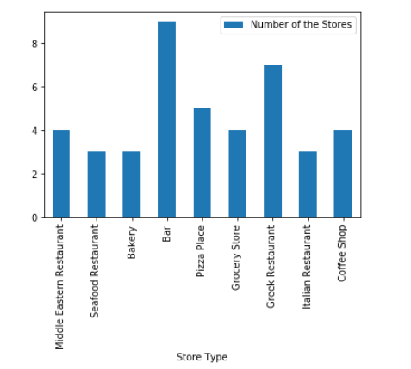
Queens
Compare to Manhattan, Queens is the place for party
Queens has 9 bars within 1000 meters
Advantages: It meets the second require from the business owner
Disadvantage: it has about the same amount of the competitors as Manhattan
More alternatives

Slide 6
Business Suggestions
From the data, Queens seems like the place for food and drinks
About the same amount of the competitors, but more complementary goods; bars, pubs
Pizza store has price advantage compare to other restaurant on the same area

